Slide 1
The Simple Economics of Affirmative
Action Policies
Glenn C. Loury
Univ. of Michigan, March 11, 2012

Slide 2
This Lecture Will Consist of Two Parts:
  A discussion of some of the general questions or themes that arise in the context of debates about affirmative action policies, as well as a brief review of my prior research on this topic.
  A theoretical analysis of one specific model intended to shed light on the question of the optimal design of affirmative action programs.

Slide 3
General Considerations Concerning Affirmative Action Policies and Review of Prior Research

Slide 4
Affirmative Action Policies Practiced Globally
  South Africa: ‘Black Economic Empowerment’ policy post-Apartheid with racial hiring guidelines for firms
  US Supreme Court issues frequent rulings on legality of AA in employment, higher ed. and govt. contracts
  India: extensive AA for Dalits (in constitution) & OBC’s
  Malaysia: New Economic Policy (introduced after 1969 ethnic riots; many AA features remain in place)
  AA policy debate underway in Europe (esp. France)
  Also Sri Lanka; Indonesia; Nigeria; Lebanon; China…

Slide 5
Some of My Papers on Affirmative Action
  Coate-Loury [Stephen Coate, Economics, Cornell]
    AER 1993: Show how AA can worsen racial stereotypes
    AER Proceedings 1994: Show how overly ambitious AA goal can lead to the undercutting of skill acquisition incentives
  Loury
    Bowen and Bok’S The Shape of the River (1998) [Forward]
  Chatterjee-Loury [Debipriya C., Univ. Wisc-Milw.]
    Dissertation/under review: AA in Hierarchies.
  Fryer-Loury [Roland Fryer, Economics, Harvard]
    JEcIneq 2005: Study optimal handicapping of tournaments
    JEP 2005: Dispels some popular “myths” surrounding AA
    JLEO 2008: Estimate cost of color-blindness in US higher ed)
    Under review: Study the design of affirmative action policy as an optimal-taxation/mechanism-design problem

Slide 6
The Typical Affirmative Action Scenario
- Some demographic group -- defined by race, ethnicity, or gender is presumed to be ‘socially disadvantaged.’
- High-status positions scarce; that disadvantaged group ‘underrepresented’ in such positions is deemed a problem.
- For a variety of reasons, a policy maker may seek to increase the disadvantaged group’s representation in high status positions.
- AA policies are thus departures from purely ‘meritocratic’ selection in the interest of achieving greater ‘diversity’. (Ironically?) Affirmative Action policies presuppose elitism: they seek to promote the racial integration of elite cadres.

Slide 7
Questions of Interest about AA Policy
What is impact of affirmative action policy on the formation of racial stereotypes?
[CL-AER 1993 showed how a ‘patronizing equilibrium’ can arise under AA]
When will AA policies undercut incentives to acquire skils?
[CL-1994 showed too ambitious goals imply bottlenecks; virtues of gradualism]
Is AA best employed early or late in the process of skill development?
[FL – present study asks: should the focus of AA policies be at the preparatory stages or rather at the final stages of the competition for scarce positions?]

Slide 8
More Questions
Can racial preference policies be designed which avoid explicit racial discrimination
What do such 'color-blind' AA policies look like, and how efficient are they, relative to the 'color-sighted' alternative?
[Loury et al. entered Supreme Court brief in Univ. Michigan cases on just this question. FLY – 2008 further analyze the ‘College and Beyond’ assessing efficiency of CBAA]

Slide 9
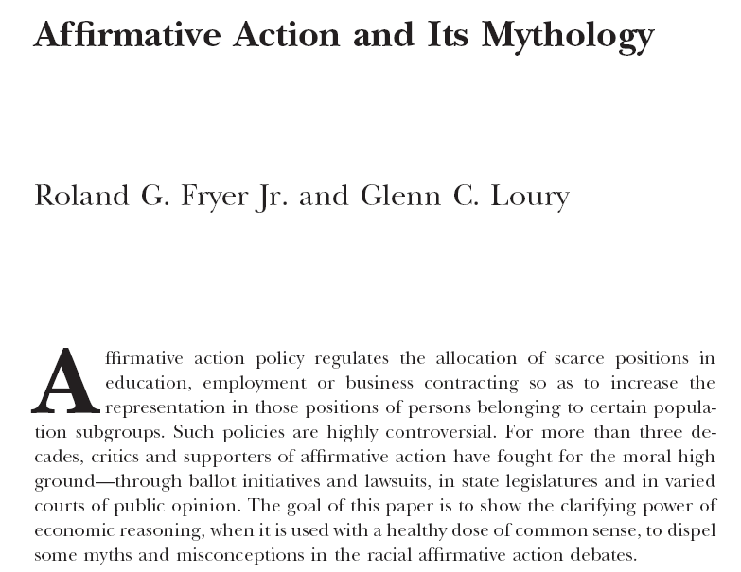
Some General Economic Issues with Affirmative Action Policies

Slide 10

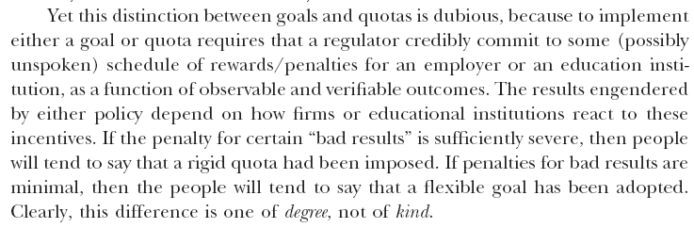

Slide 11

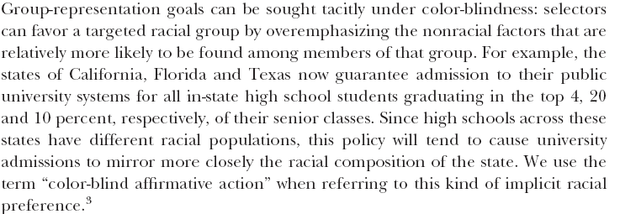

Slide 12
Alternatives to Racial Preferences:
An Empirical Assessment of Color-Blind Affirmative Action in US College Admissions
(Fryer, Loury and Yuret 2008)

Slide 13
Affirmative Action without Explicit Racial Discrimination
Color-blind (non-racially discriminatory) affirmative action exploits statistical associations in the population between an applicant’s racial identity and his/her non-racial traits
[Texas 10% Plan famously illustrates the non-transparency]
A policymaker alters the weight given to non-racial traits for all applicants in such a way as to increase the yield in selection process from a targeted group.
One consequence of this kind of policy is that selection efficiency must in general be reduced for all applicants. Policy can’t be ‘conditionally’ (within group) meritocratic.

Slide 14
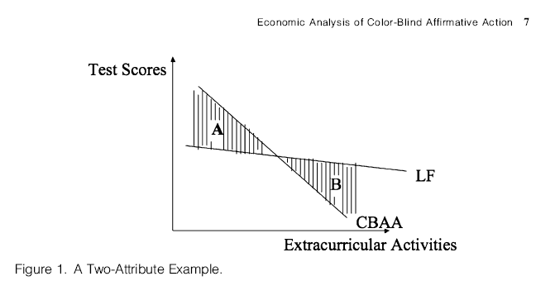
An Illustrative Example of Color-Blind Affirmative Action
Students in area A are excluded, and in area B are included, by the policy. There
are more disadvantaged group students to be found in area B than in area A.

Slide 15


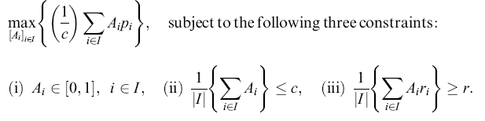
Use Data to Estimate (presumed) Linear Relationships
Academic Performance Equation:
Racial Identity Equation [prob {applicant in targeted group}]:
Finding an Optimal Policy: The Planner’s Problem

Slide 16
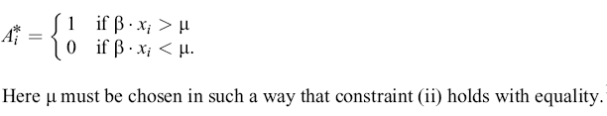
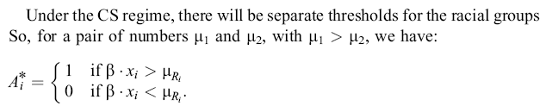

Laissez-Faire Solution: Threshold Rule on Predicted Performance
Color-Sighted Affirmative Action Solution: Race-Specific Thresholds

Slide 17
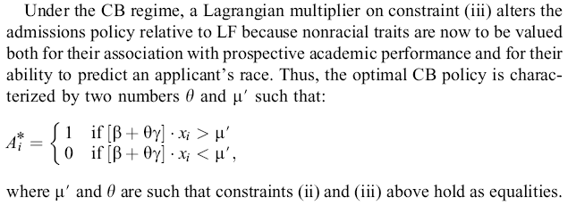
Color-Blind Affirmative Action: Modified weights in scoring equation

Slide 18
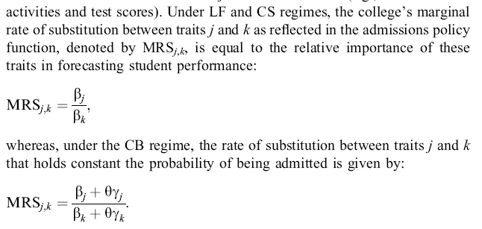

Slide 19
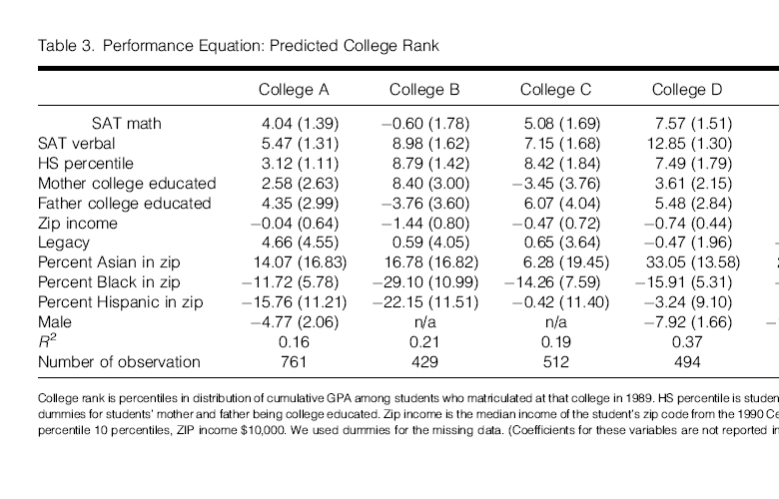

Slide 20
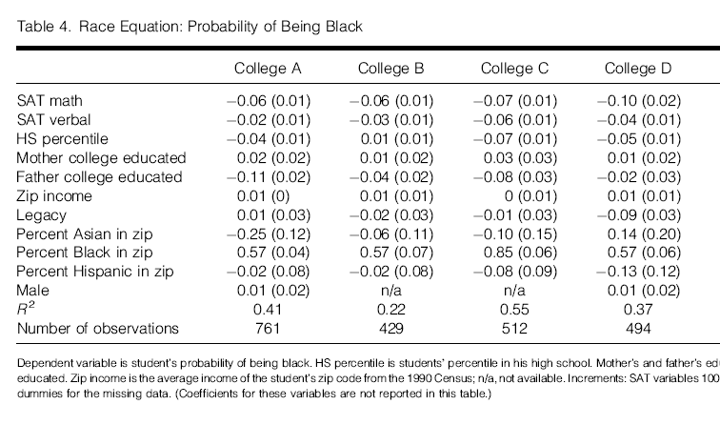

Slide 21
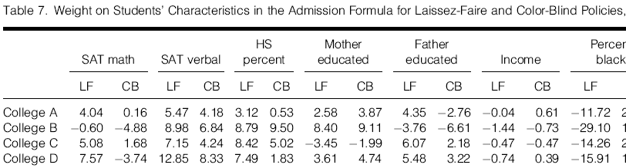

Slide 22
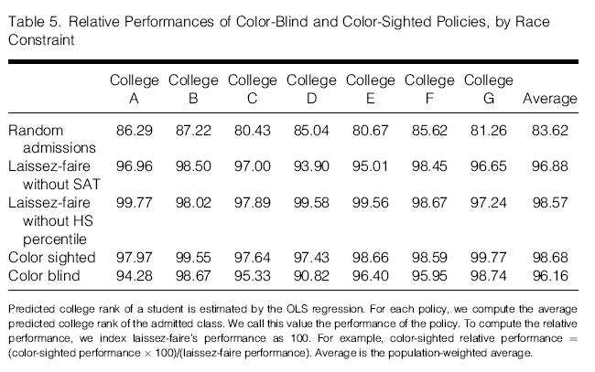

Slide 23
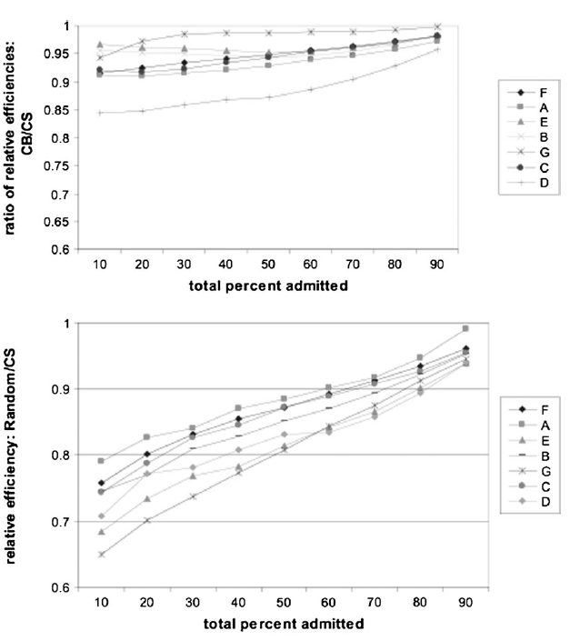

Slide 24
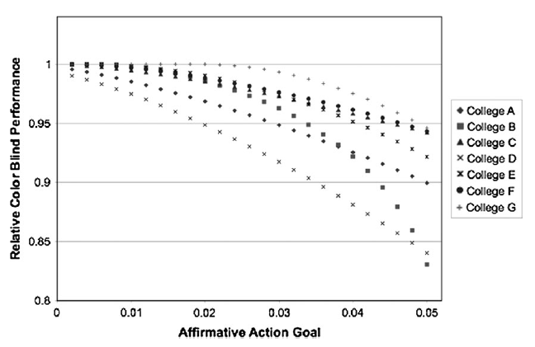

Slide 25
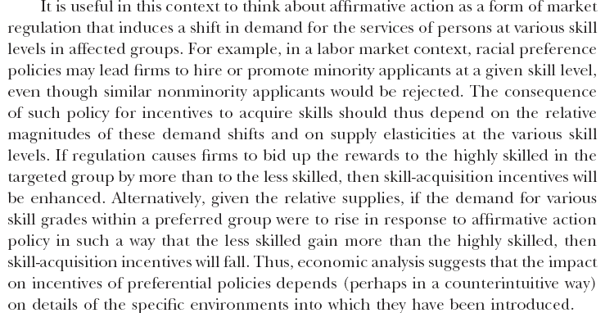

Slide 26
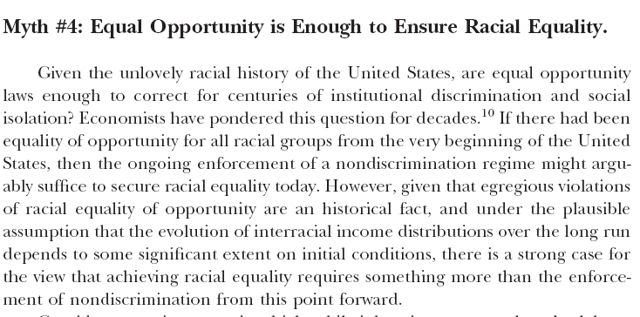

Slide 27
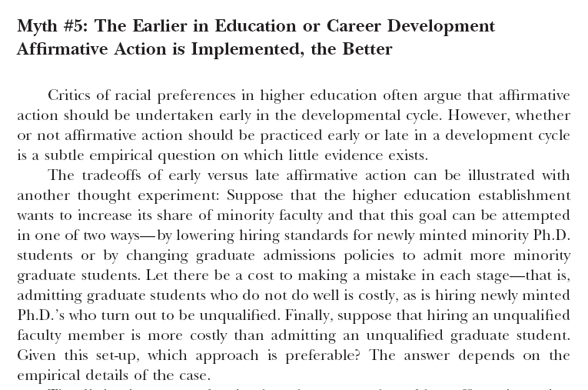

Slide 28
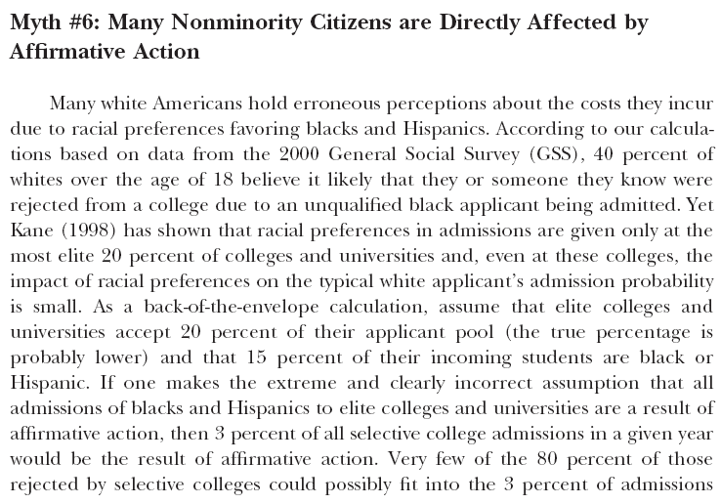

Slide 29
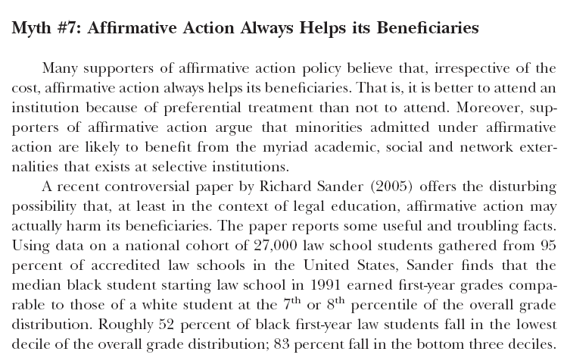

Slide 30


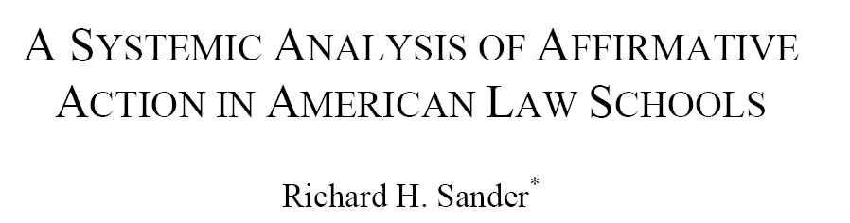
Why Is Affirmative Action So Controversial? The Case of US Law Schools
Law schools are among the most hotly contested arenas where
racial affirmative action is employed. Excellent data exist on law
school admissions practices. These data reveal the extent of AA
and permit some assessment of the policy’s effects.

Slide 31
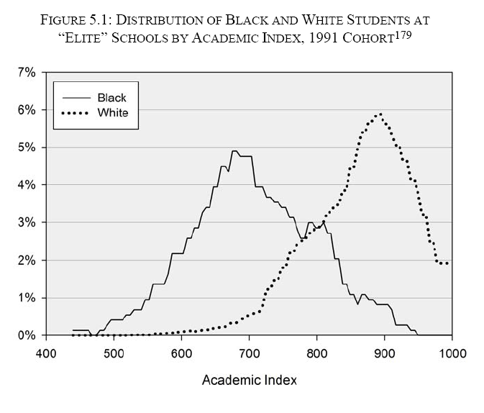

Slide 32
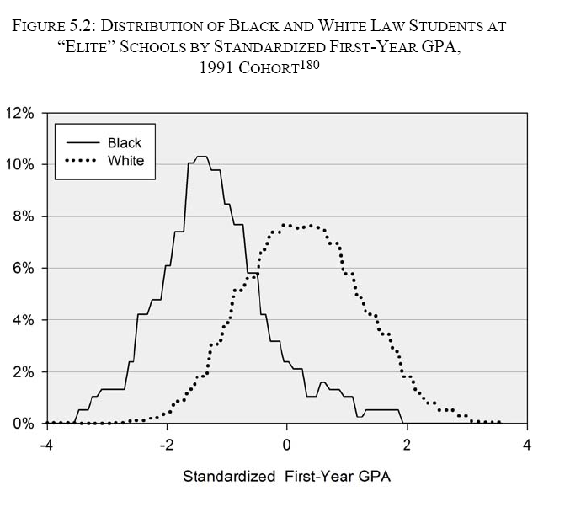

Slide 33

Richard Sanders’ Conclusions

Slide 34
The Abstract Design Problem: A Simple Theoretical Model of Optimal AA Policy

Slide 35
Dimensions of Policy Design
In general one can distinguish affirmative action policies along two dimensions: Timing and Sightedness
Timing refers to where in the development process a policy operates – ex ante (at the development margin) or ex post (at the assignment margin)
Sightedness refers to whether the policy is group-blind or not – that is, whether or not implementing the policy requires information about an individual worker’s group identity.

Slide 36
Elements of A Basic Model
- There is a continuum of workers, two groups, A and B
- There is a continuum of ‘slots’, each filled by one worker
- At ex ante stage, workers acquire human capital (or not)
- HC is costly, and cost distributions differ between groups
- At ex post stage, some workers gain access to scarce ‘slots’
- For workers in a ‘slot’ output equals worker’s productivity
- HC investment (stochastically) raises worker productivity
- ‘Slots’ are privately held, inelastically supplied, and sold to highest bidders. A group’s representation amongst slot-holders reflects the distribution of ex post productivity for that group.

Slide 37
Preview of results
In baseline model, under laissez-faire, CE is efficient; the disadvantaged acquire less HC; and they are underrepresented in slots.
Under sightedness, optimal AA policy entails ex post (late) but no ex ante (early) subsidies for the disadvantaged group.
Under blindness, optimal AA policy entails slots rationing ex post. Ex ante (HC) subsidies are desirable if and only if disadvantaged relatively more numerous on development margin than on assignment margin.

Slide 38
(1) Development vs. Assignment Margin
(2) Blind vs. Sighted preferential policy.
Development
margin
Assignment
margin
Regulator
commits
to a policy
Agents
receive
endowments
Agents
choose
effort
Agents
learn their
productivities
Slots
are
allocated
Production
occurs
and payment
received
Figure 1: Sequence of Actions

Slide 39
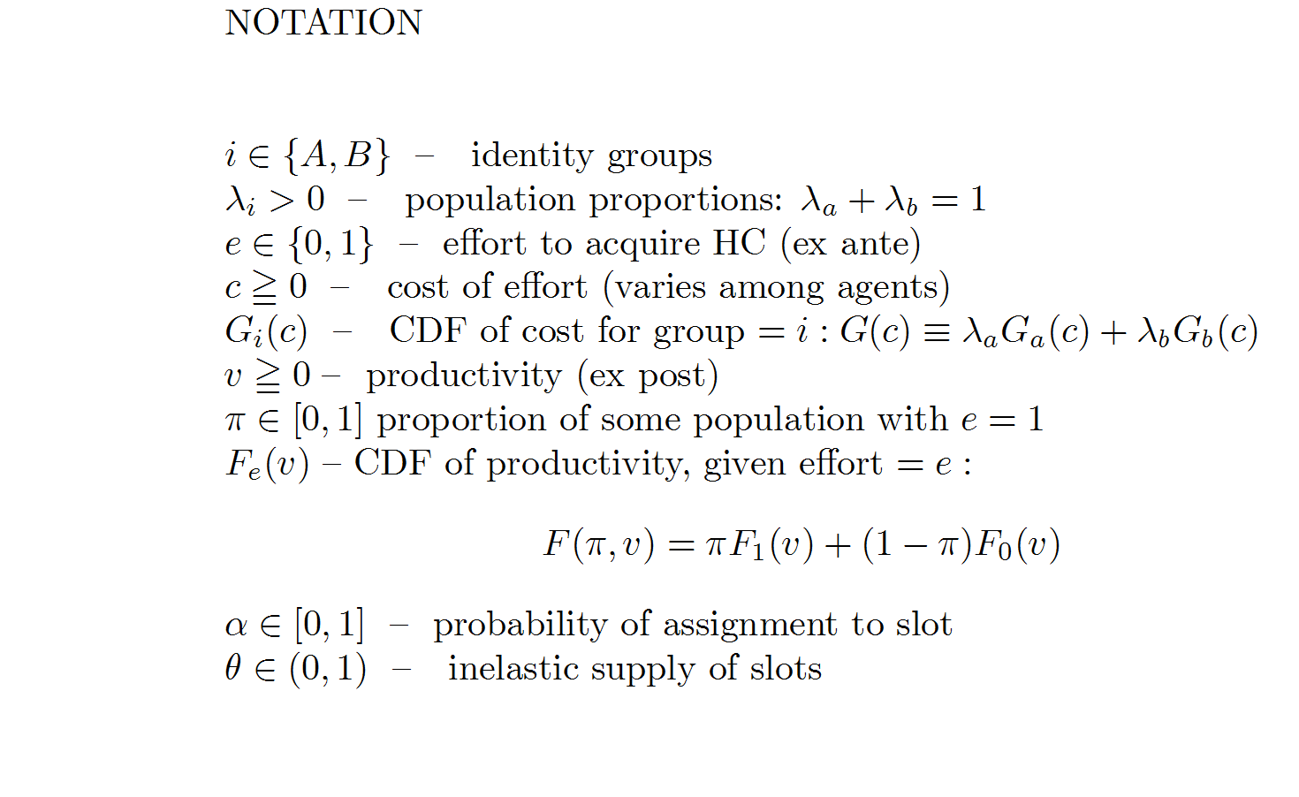

Slide 40
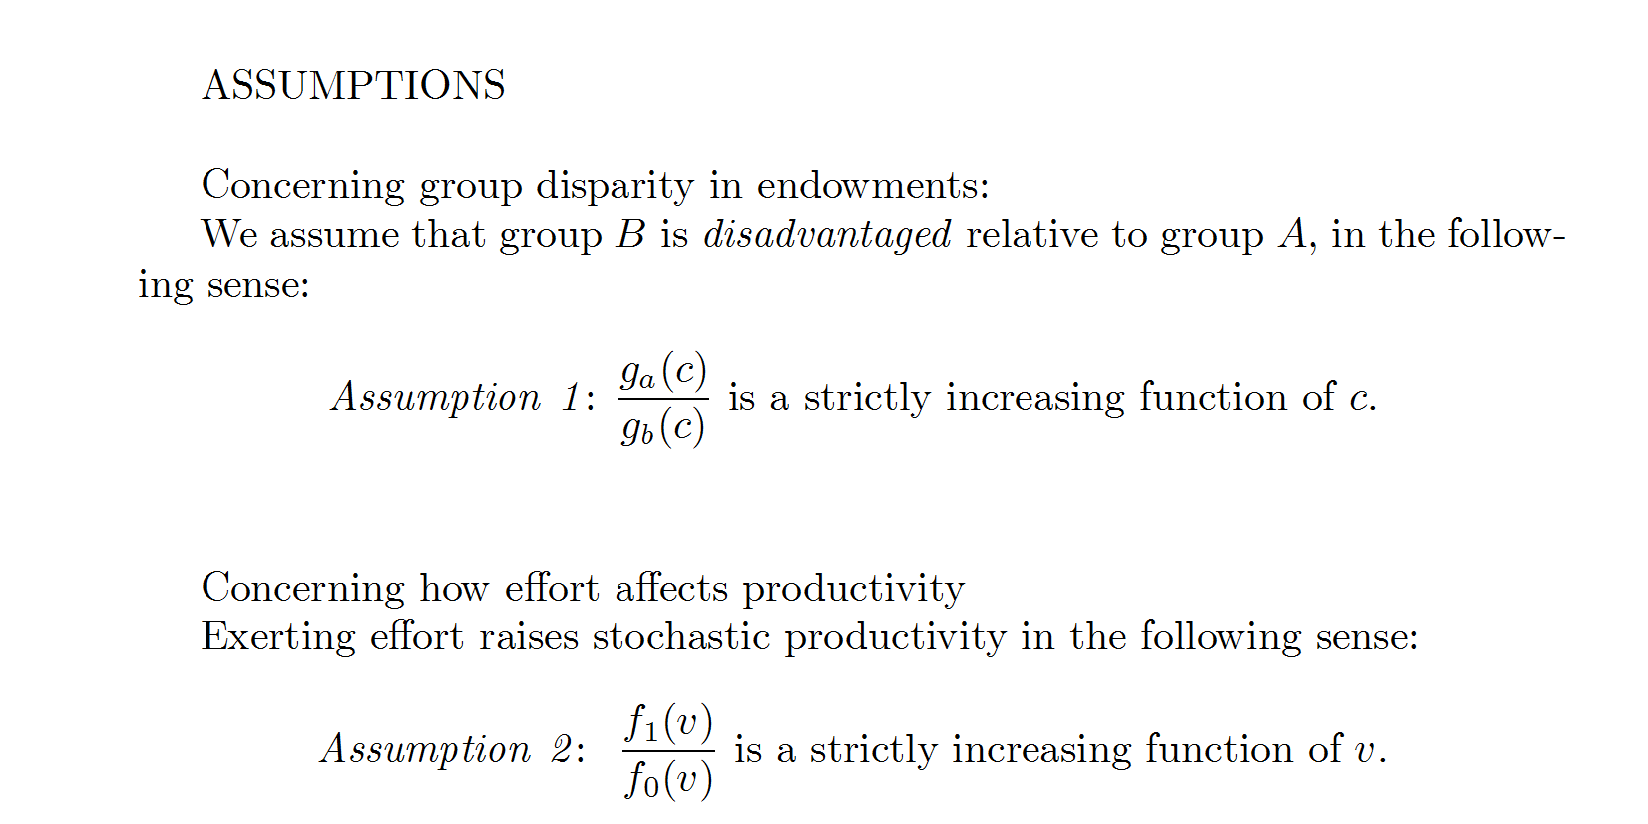
decreasing

Slide 41
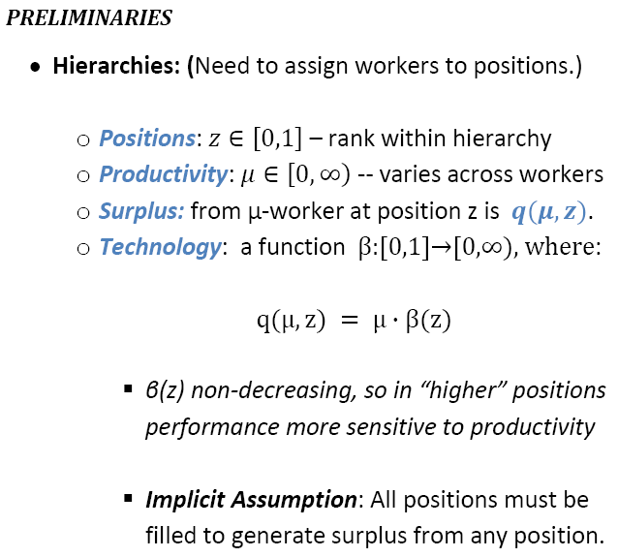

Slide 42
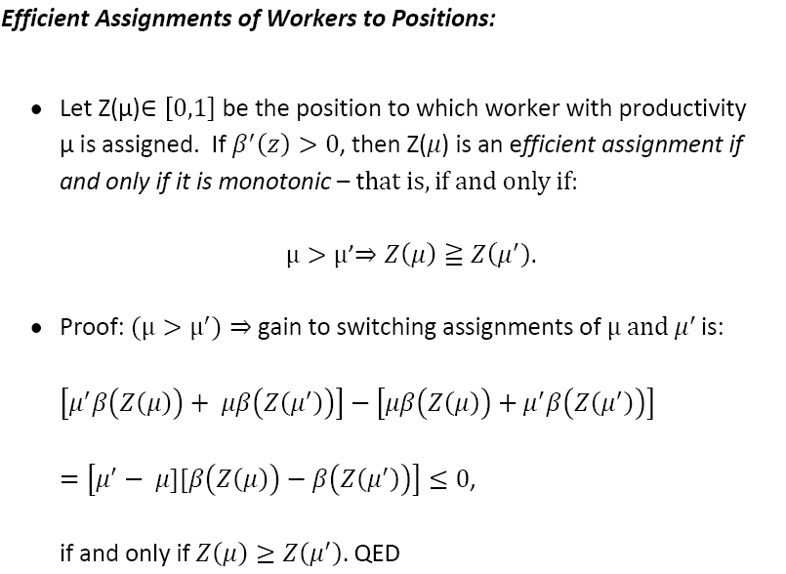

Slide 43
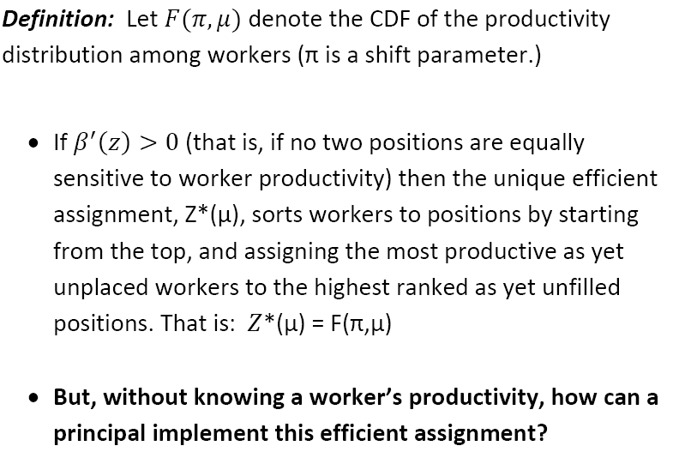

Slide 44
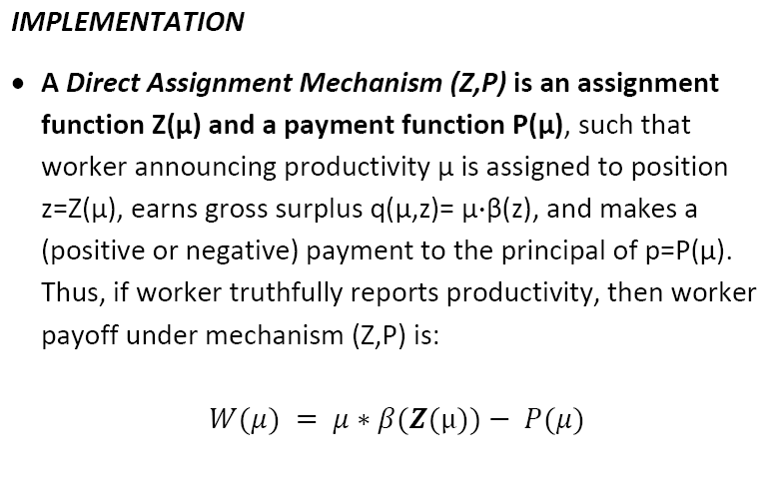

Slide 45
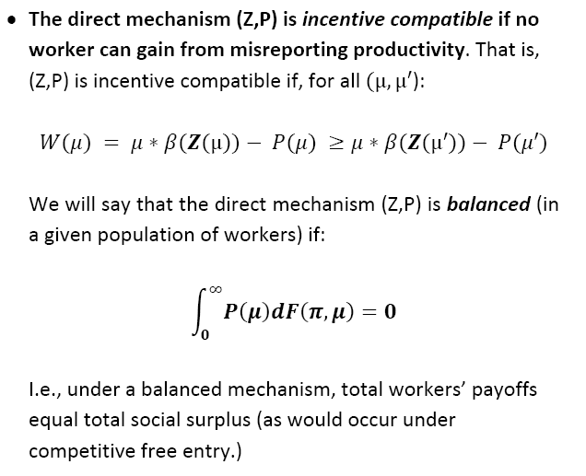

Slide 46
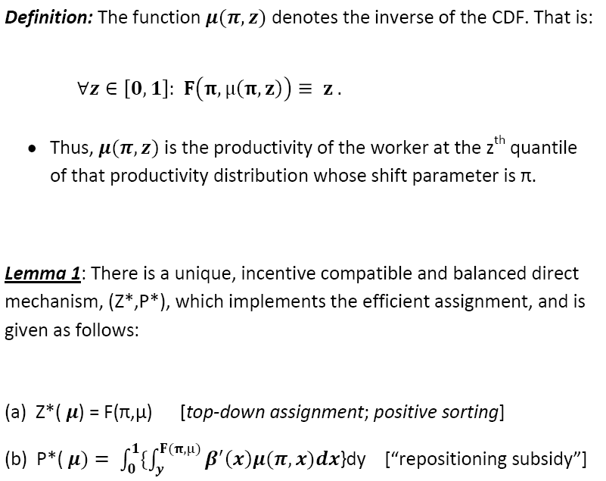

Slide 47
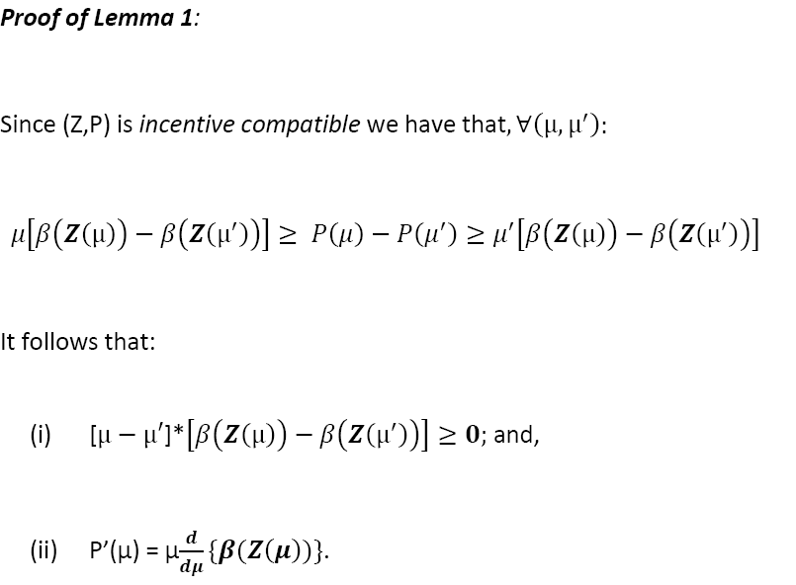

Slide 48
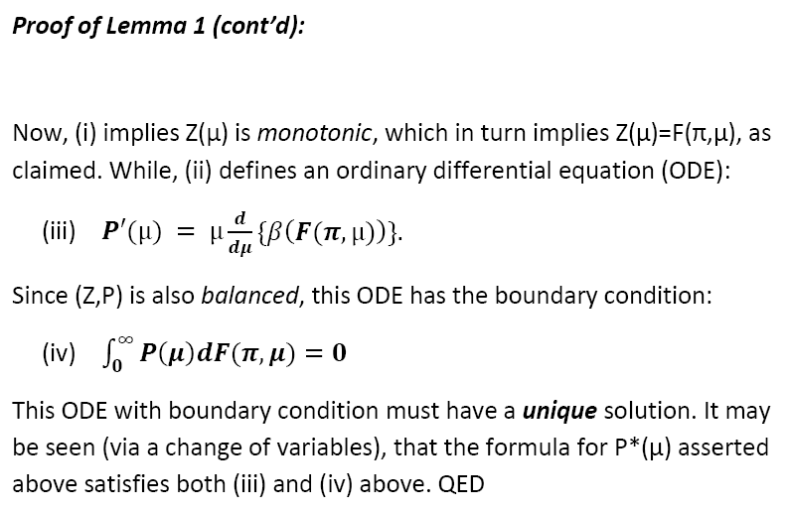

Slide 49
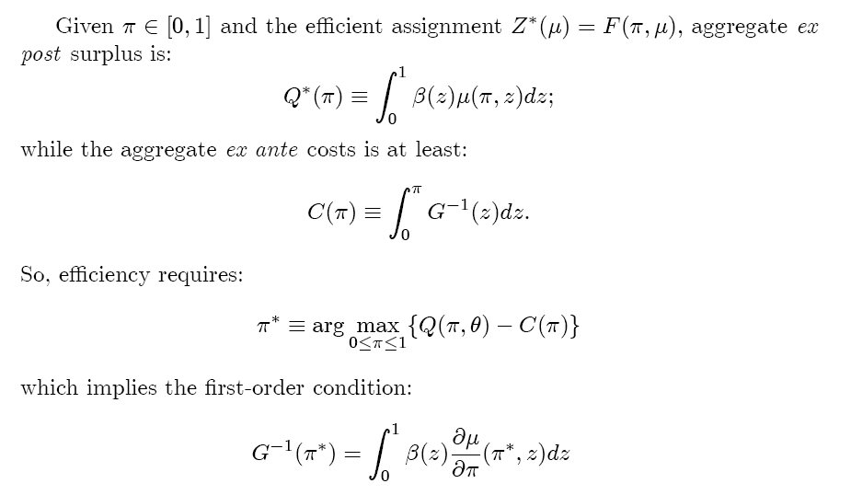
Efficient Investments in Skills

Slide 50
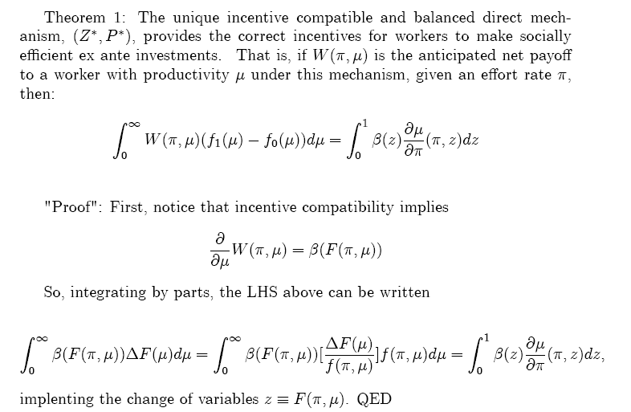

Slide 51
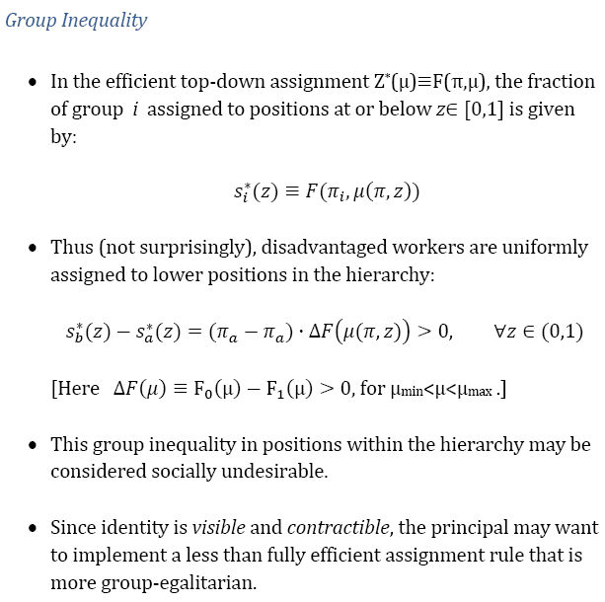

Slide 52
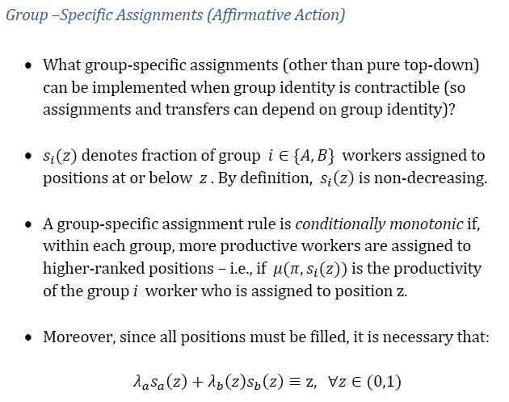

Slide 53
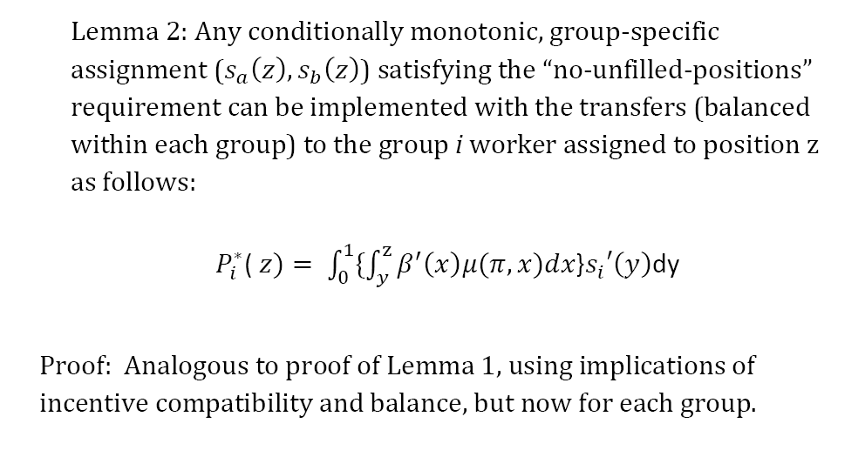

Slide 54
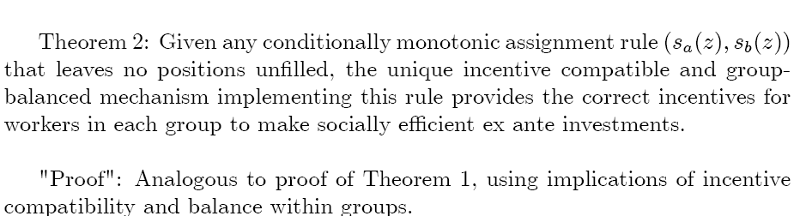

Slide 55
Special Case: One Desired Position

Slide 56
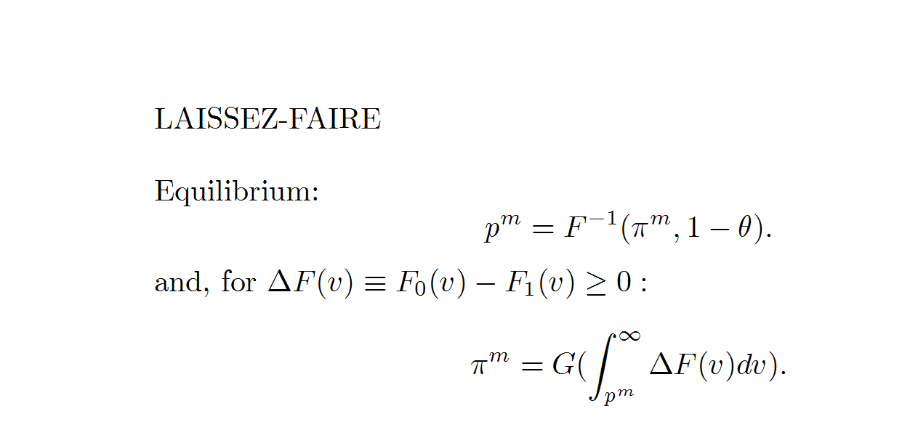

Slide 57
1
p
Figure 2: Competitive Equilibrium under Laissez-faire

Slide 58
A more general formulation of the resource allocation problem under LF:

Slide 59
Optimal resource allocation under LF:

Slide 63
The key point is that, given the representation constraint, net
social surplus depends entirely on the group specific rates of
HC investment, π-sub-i, i=A,B. So, the constrained optimal AA
policy is the one which induces groups to acquire HC at the
surplus-maximizing, group-specific rates.

Slide 65
Hence, without any further loss of generality we may characterize
optimal sighted AA policy, both ex ante and ex post, by finding the pair
of group-specific investment rates which maximize net social surplus
subject to the capacity and representation constraints, and then by
“backing out” the action-contingent transfers needed to induce the
lowest cost agents in each group to invest at these optimal rates.
But, this implies that the optimal policy entails no ex ante subsidy
for investment by members of the disadvantaged group!

Slide 67
MC, MB
Figure 3: Optimal Sighted Affirmative Action

Slide 68
Remark: It may be shown that this policy of ex post ‘price-ceiling’ plus ex ante
HC tax-subsidy is constrained-optimal amongst all feasible, blind policies under
a stronger version of the MLRP, such that the likelihood ratio not only increases
with the level of worker productivity, v, but is also a convex function of v.

Slide 74
Doing the calculation we may write the necessary condition for optimality as:

Slide 76
We conclude that optimal blind affirmative action policy entails
a universal subsidy (tax) for ex ante human capital investments
whenever the disadvantage group is has higher (lower) presence
on the development margin than it has on the assignment margin.
I.e., σ>0 only if (g-sub-B/g), when evaluated at the
development margin, is greater than (f-sub-B/f) when
evaluated at the assignment margin.

